Slide 1
Pure Metals : Nucleation & Growth
Solidification does not happen on cooling instantaneously on cooling below T_{m}
and takes place via nucleation and growth.
Nucleation:
 homogeneous – rare and only if very large undercooling ∆T;
 heterogeneous – on mould walls and/or “impurities”
(including deliberate alloy additions to grain refine microstructure)
Growth may be affected by temperature gradients and preferred crystal growth
directions.
Homogeneous Nucleation
When a solid forms within its own liquid without aid of foreign materials
 nucleate homogeneously .
Homogeneous nucleation requires a large driving force (undercooling)
because of the relatively large contribution of surface energy to the total free energy of small particles.
Heterogeneous Nucleation
Nucleation occurs on preferential sites , such that a solid forms in contact
with a impurity particles, i.e. nucleation agent or mold walls 
heterogeneous nucleation.
Many liquid metals start solidification in a few degrees of supercooling.
Solidification of materials
2

Slide 2
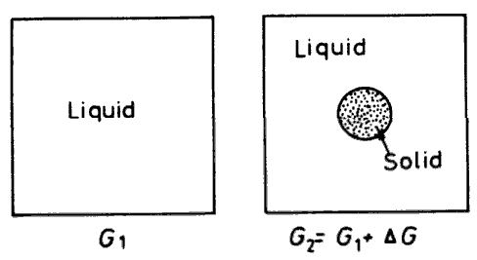
Homogeneous Nucleation
(I)
Free energy of liquid at a temp. ΔT below T_{m}  G₁
G₁ = (V_{S} + V_{L} )G_{V}
If some of atoms of liquid cluster together form a small cluster sphere of solid, the free energy of the system will change to G₂
F f li id t t T b l 
L
S
L
G₂ = V_{S}G_{V} + V_{L}G_{V} +
A_{SL} γ _{SL}
V_{S} : volume of solid sphere,
V_{L} : volume of liquid
G ^{S} , G ^{L} : free energies per unit volume of solid and liquid respectively
V
V
A_{SL} : solid/liquid interfacial area, γ_{SL} : solid/liquid interfacial free energy
Free energy change due to the formation of solid
ΔG = G₂ − G₁
= −V (G^{L} − G^{S} ) + A γ
S V
V
SL SL
= −V_{S} ΔG_{V} +
A_{SL} γ _{SL}
ΔG_{v} is positive below T_{m} , so that
 Negative contribution due to the lower free energy of a bulk solid
 Positive contribution due to the creation of solid/liquid interface
Solidification of materials
3

Slide 3
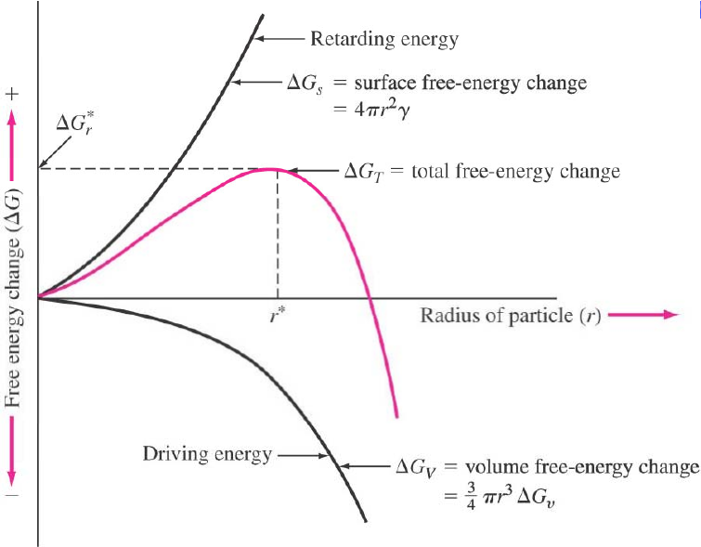
Homogeneous Nucleation (II)
ΔG = −V_{S} ΔG_{V} +
A_{SL} γ _{SL}
The excess free energy associated with the solid particles can be minimized by
the formation of sphere of radius r
_{ΔG = −} ⁴ _{πr}³ _{ΔG}
3
+ 4πr²
γ
V
SL
If a very small solid particle forms, the retarding energy (ΔG_{s}) term is larger
than the driving energy (ΔG_{v}).
 the creation of small solid particles leads to a free energy increase.
 liquid phase is able to maintain in a metastable state almost infinitely at
temperatures below T_{m}.
Solidification of materials
4

Slide 4
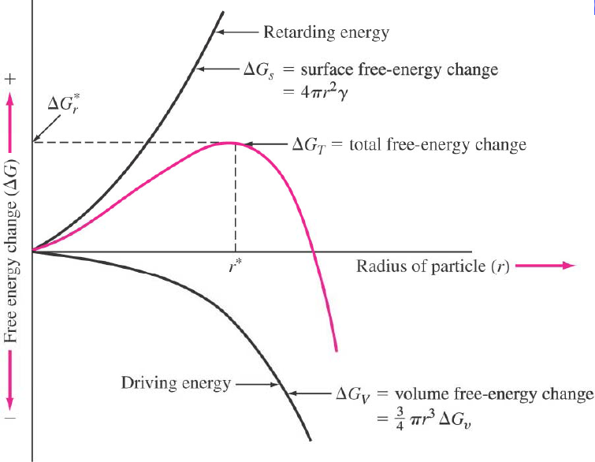
Homogeneous Nucleation
(III)
_{ΔG = −} ⁴ _{πr}³ _{ΔG}
3
+ 4πr²
γ
V
SL
At a given ΔT,
If r < r*, a small increase in radius Δr results
in an
increase
of the total
free energy which is not a spontaneous process.
 the system can lower its free energy by dissolution of solid particle
 unstable solid particles with r < r*,  embryos
Only if r > r*, the growth of solid proceeds spontaneously with decrease
in free energy of the system.
 the system can decrease its free energy by growth of solid particle
 stable solid particles with r > r*,  nuclei
r* is called as critical radius of "nuclei" (clusters which are able the grow).
i ll d i i l di f l i l hi h bl h
At the critical radius the total free energy change has a maximum ΔG* which
is known as nucleation barrier.
Solidification of materials
5

Slide 5
Homogeneous Nucleation (IV)
Estimation of the size of the critical radius
dG = 0 when r = r*  the critical nucleus is in equilibrium with the surrounding liquid
di li id
Differentiation of the total free energy equation with
respect
to
r,
and
dΔG
= 0 ,
at r = r*
dr
r =r*
_{ΔG = −} ⁴ _{πr}³ _{ΔG}
3
+ 4πr² γ
V
SL
dΔG
dr
G
= −4πr^{*2} ΔG + 8πr* γ
= 0
r =r *
V
SL
and therefore,
_{r}∗ ^{2γ} SL
=
=
⎛ 2γ _{SL} T_{m}
⎞ 1
⎜
⎝
⎟
ΔG_{V}
L ⎠ ΔT
3
3 2
16πγ
⎛ 16πγ T
⎞
1
ΔG∗ =
^{SL} ⎜ ^{SL m} ⎟
3(ΔG
)²
=
⎜
3L^{2 ⎟} (ΔT)²
V
⎝
⎠
The size of r* is reduced by greater undercooling (ΔT), this means that
smaller nuclei are able to grow.
Without undercooling, the nucleation will not start (if ΔT = 0, then r* 
∞).
The nucleation barrier ΔG* is also inversely related to ΔT: the nucleation
barrier decreases as the undercooling increases.
Solidification of materials
6

Slide 6
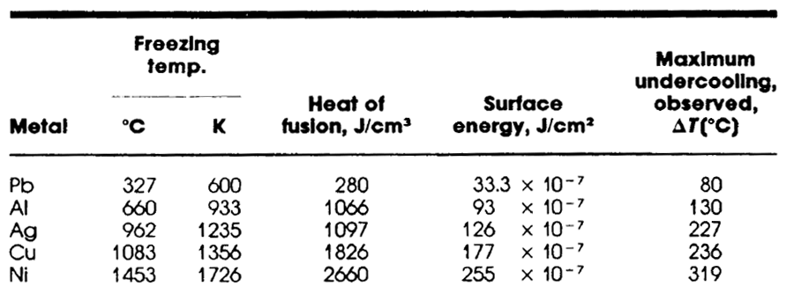
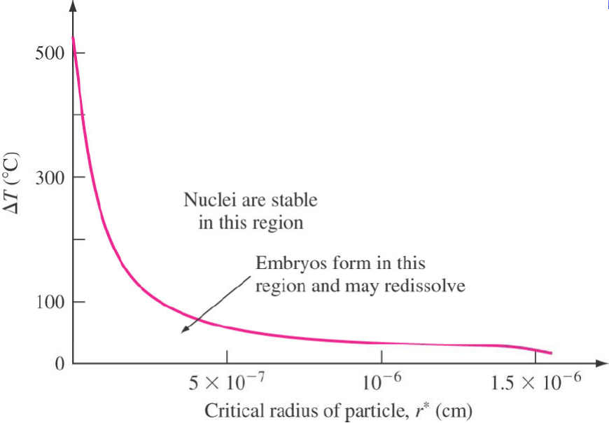
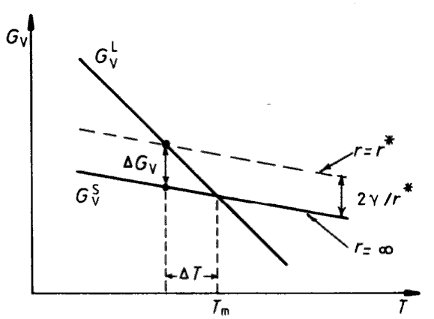
Homogeneous
Nucleation
(V)
For
FCC
Copper, r*≈1 nm,
which
contains
310
Cu
atoms
in
each
nucleus.
A solid sphere of r will have a free energy greater than that of bulk
solid by 2γ/r per unit volume.
Solidification of materials
7

Slide 7
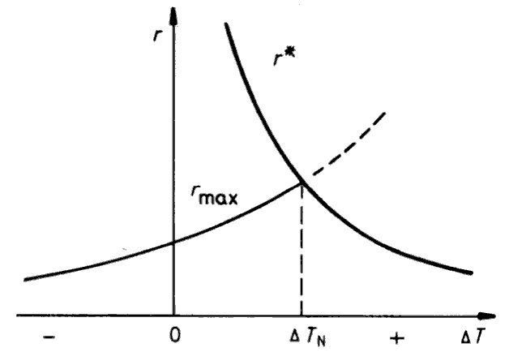
Homogeneous Nucleation (VI)
Formation of solid nucleus
Many small close-packed clusters of atoms (crystalline atomic array)
present in the liquid
Total number of atoms in liquid, n₀
The number of spherical clusters of radius r, n_{r}
ΔG_{r )}
n = n exp(−
r
0
kT
ΔG_{r} : the excess free energy associated with cluster,
k : Boltzmann constant
For a liquid above T_{m} , this relationship applied for all values of r,
but for a solid, the relationship only applied for r ≤ r*
Since n_{r} decreases exponentially with ΔG_{r} (which itself increases rapidly
with r), the probability of finding a given cluster decreases very rapidly as
the cluster size increases
for example) at T_{m}, Cu (10²⁰ atoms/mm³) contains ~10¹⁵ clusters of
0.3 nm (~10 atoms) and ~10 clusters of 0.6 nm (~100 atoms)
Maximum size of clusters in the liquid
increases with decreasing temperature.
Critical nucleus size r* μ 1/ΔT
For supercollings of DTN or greater,
 some clusters reaches r*, and growing into stable solid particles
Solidification of materials
8

Slide 8
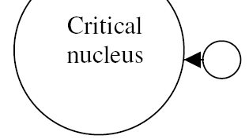
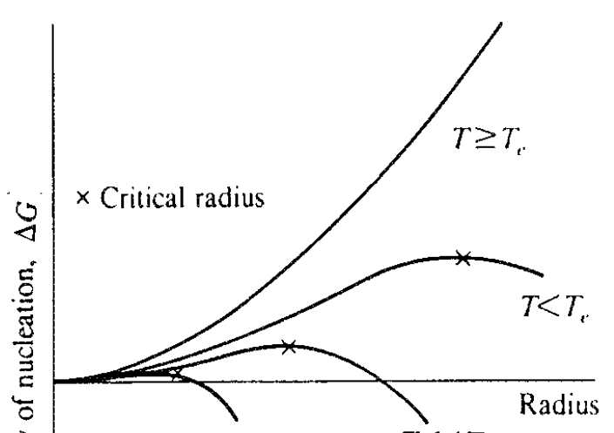
Homogeneous Nucleation (VII)
Homogeneous Nucleation Rate
The cluster with a critical radius r* will convert stable nucleus by addition of
a single atom to a critical nucleus
P : frequency with which the addition of a single atom to a critical nucleus makes that nucleus is supercritical and able to grow rapidly
P =
¹n
να exp(−
^{ΔGi} ₎
kT
6
L
1/6 : possibility with which atom directs to the L/S interface
n_{L}
ν
α
: the number of atoms surrounding a critical nucleus
: atomic vibration frequency (~kT / h, h : Plank constant)
: possibility with which each atom jumps across the L/S interface
exp (-ΔG_{i}/kT) : thermodynamic barrier to join atom to critical nucleus
( /kT) th d i b i t j i t t iti l l
- Nucleation Rate,
Nhom
∗
N = n P =
¹_{n}
6
n να exp(−
^{ΔGr + ΔGi} )
hom
r
0 L
kT
6
∗
≅
n₀kT
h
n₀kT
exp(−
^{ΔGr} )
kT
A ⎤
2 ⎥
3 2
≅
⎡
exp
A =
16πγ _{SL} T_{m}
⎢
⎢
2
h
⎣
(ΔT)
⎦
3L kT
At low undercoolings,
the nucleation barrier is
high and the rate of nucleus formation is low.
Greater undercooling promotes the nucleation
due to decrease in r* and ΔG*.
Solidification of materials
9

